Slide 1


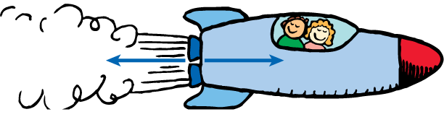
Newton’s 3rd Law Notes
For every force, there is an equal and opposite force.

Slide 2
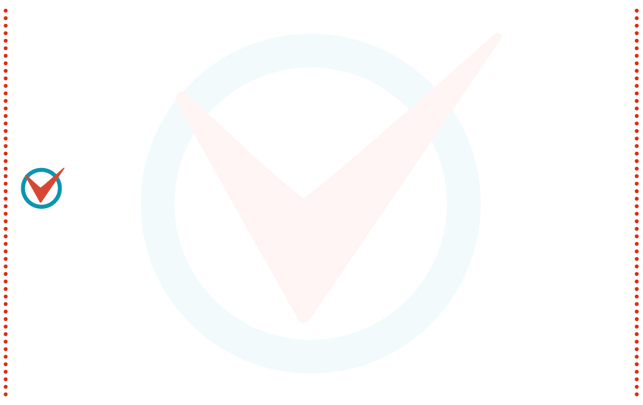
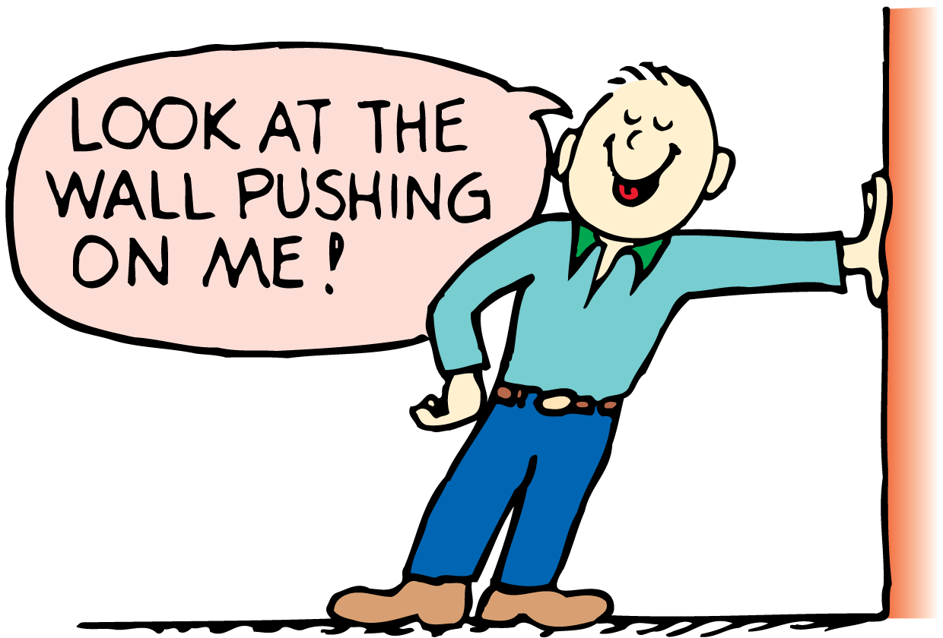
Forces and Interactions
A force is always part of a mutual action that involves another force.
In the simplest sense, a force is a push or a pull.
A mutual action is an interaction between one thing and another.
When you push on the wall, the wall pushes on you.

Slide 3
Newton’s Third Law
Newton’s third law states that whenever one object exerts a force on a second object, the second object exerts an equal and opposite force on the first object.

Slide 4
Newton’s Third Law
Newton’s third law describes the relationship between two forces in an interaction.
  One force is called the action force.
  The other force is called the reaction force.
  Neither force exists without the other.
  They are equal in strength and opposite in direction.
  They occur at the same time (simultaneously).

Slide 5
Newton’s Third Law
The interactions in these examples depend on friction.
A person trying to walk on ice, where friction is minimal, may not be able to exert an action force against the ice.
Without the action force there cannot be a reaction force, and thus there is no resulting forward motion.

Slide 6
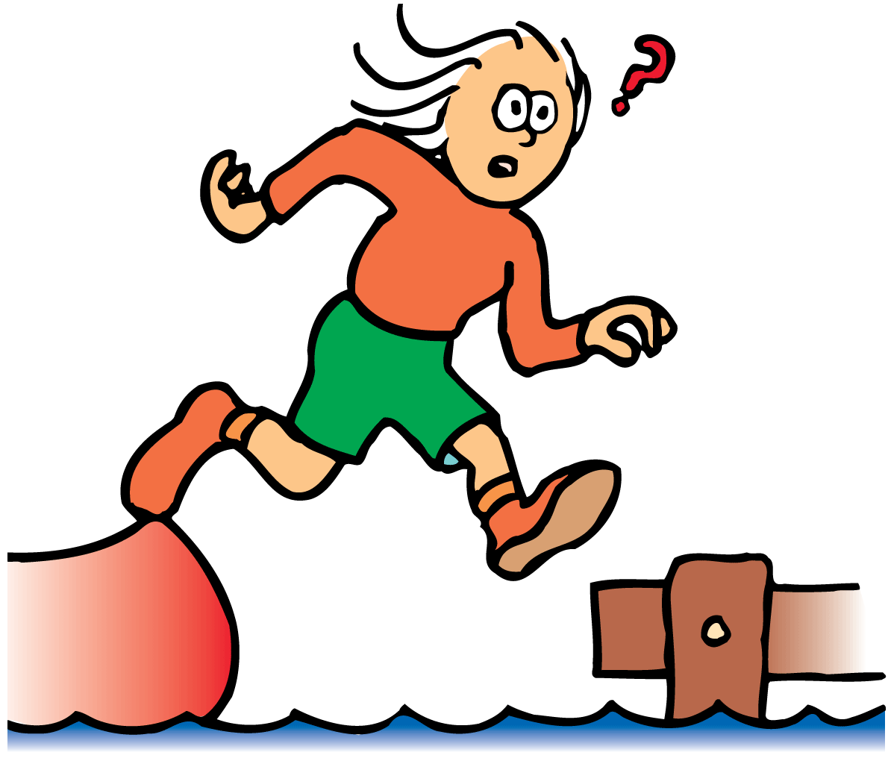
Newton’s Third Law
When the girl jumps to shore, the boat moves backward.

Slide 7
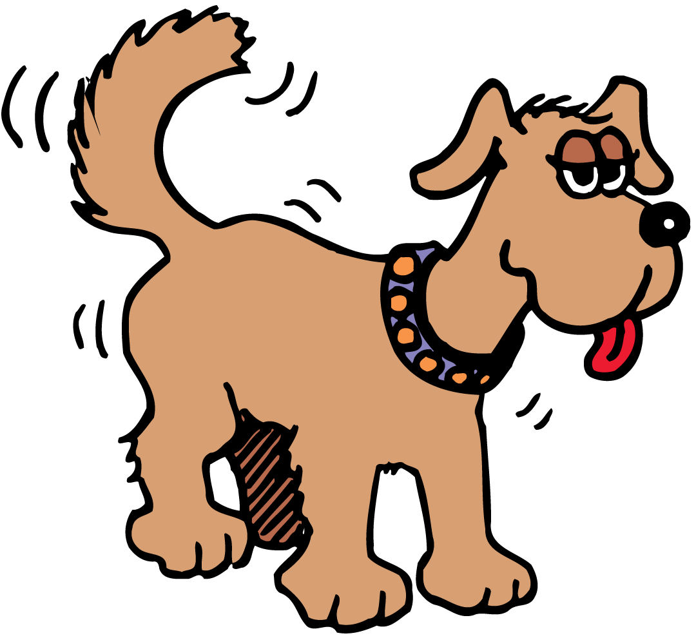
Newton’s Third Law
The dog wags the tail and the tail wags the dog.

Slide 8
Identifying Action and Reaction
To identify a pair of action-reaction forces, first identify the interacting objects A and B, and if the action is A on B, the reaction is B on A.

Slide 9
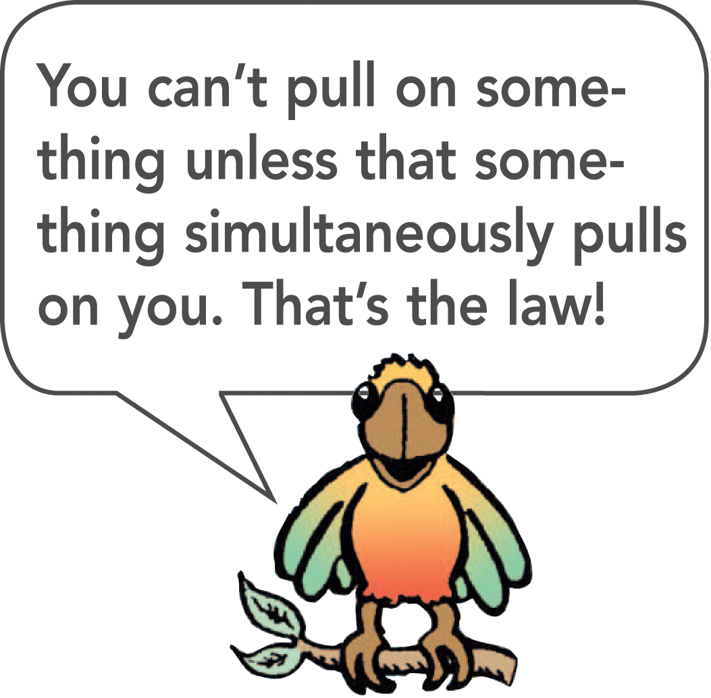
Identifying Action and Reaction
There is a simple recipe for treating action and reaction forces:
  First identify the interaction. Let’s say one object, A, interacts with another object, B.
  The action and reaction forces are stated in the form:
Action: Object A exerts a force on object B.
Reaction: Object B exerts a force on object A.

Slide 10
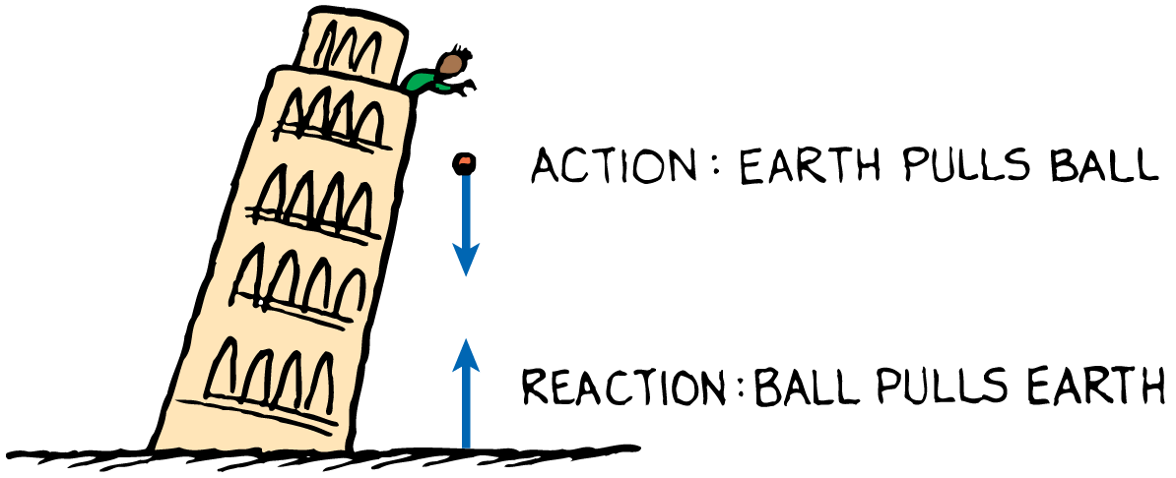
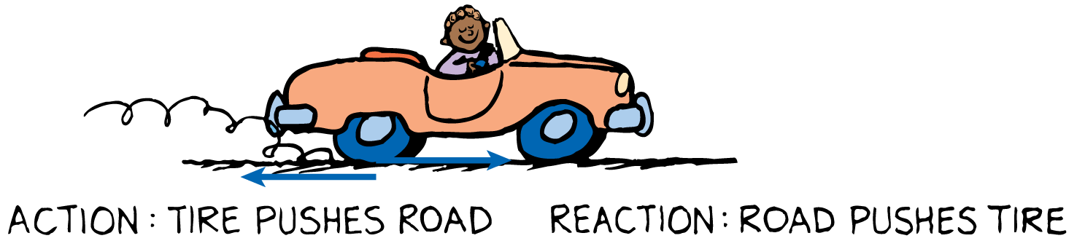
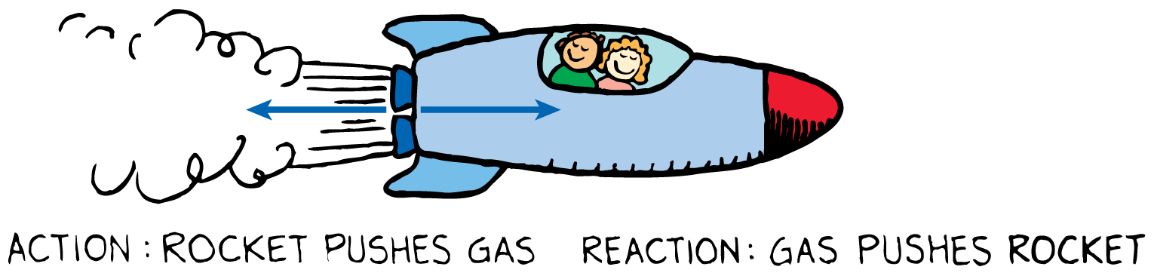
Identifying Action and Reaction
When action is A exerts force on B, the reaction is simply B exerts force on A.

Slide 11
Action and Reaction on Different Masses
A given force exerted on a small mass produces a greater acceleration than the same force exerted on a large mass.

Slide 12
Action and Reaction on Different Masses
When a cannon is fired, there is an interaction between the cannon and the cannonball.
  The force the cannon exerts on the cannonball is exactly equal and opposite to the force the cannonball exerts on the cannon.
  You might expect the cannon to kick more than it does.
  The cannonball moves so fast compared with the cannon.
  According to Newton’s second law, we must also consider the masses.

Slide 13
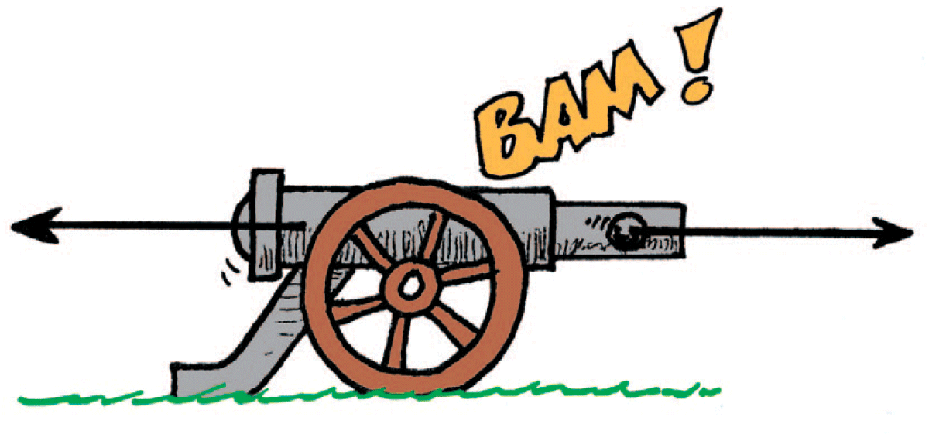
Action and Reaction on Different Masses
The cannonball undergoes more acceleration than the cannon because its mass is much smaller.

Slide 14
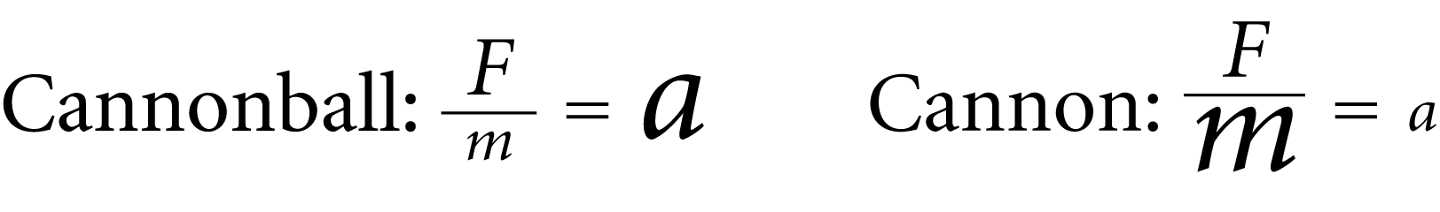
Action and Reaction on Different Masses
F represents both the action and reaction forces; m (large), the mass of the cannon; and m (small), the mass of the cannonball.
Do you see why the change in the velocity of the cannonball is greater compared with the change in velocity of the cannon?

Slide 15
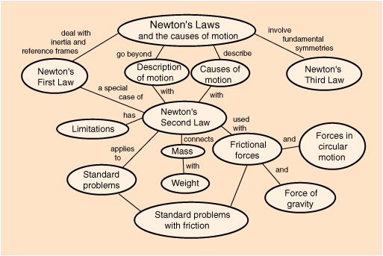

Slide 16
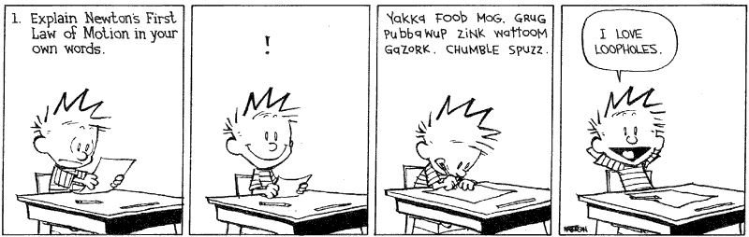
Newton’s Law Cartoons
Fold paper into 3rds, label each section for one of the laws
Draw a colored picture and include a description for each law of how the picture illustrates the law.
The pictures can have one "theme" or be individual ideas for each law
Can be completed in class or for HW - Egg drop group decision
Extra Credit Option (As I am in need of Tissues for Class)
Add a picture of Isaac Newton and the Momentum Formula on it.

